Slide 1



Title: Automated Sleep Stage Classification using Machine Intelligence Techniques: Physiological Signals, Sleep Data Presentation, and Models
3rd International Conference on Advances in
Data-driven Computing and Intelligent Systems (ADCIS 2024)
September 20-21, 2024
Paper ID:209
Authors:
Aman Patel, Om M. Patel, Visarth Dhorajiya, Santosh Kumar Satapathy
Presented by:
Om M. Patel & Aman Patel

Slide 2

PAPER OUTLINE
Introduction
Related Works
Inference from literature survey
Frame work of Sleep Staging System
Conclusion
Future Work
References

Slide 3
INTRODUCTION
Historically, the general perception of sleep is a steady state of unconsciousness. Still, the actual truth is that it has an active and dynamic life cycle, during which the brain is entirely functional.
Indeed, a proper sleep routine can significantly improve cardiac function and maintain appropriate mental restoration, attention, consolidation, and behavior.
Sleep is an essential human physiological activity.
Human beings spend approximately one-third of their lifetimes sleeping.
Sleeping is essential for the body to preserve its wellness and health.
Sleep deprivation causes a reduction in agility and output during day time, reduces concentration, and adversely affects regular circadian rhythm. It also leads to mental and physical impairments, affects immunity, reduces cognitive functioning, and causes other health issues.
Therefore, it’s essential to assess sleep quality and address the diagnosis solutions in the field of health care and sleep research

Slide 4
INTRODUCTION
Sleep is a continuous and dynamic process, which has its cyclic structural framework with a time course.
There are two main types of sleep stages as observed in human sleep, one is rapid eye movement (REM) and another one is non-rapid eye movement (N-REM) sleep.
Throughout the night the sleep cycle covers NREM and REM sleep stages cyclically and typically each cycle lasts on an average 45-60 minutes.
To analyze and classify the sleep stages, there are two main published editions containing recommendations by the committee headed by Rechtschaffen and Kales(R&K) and American Academy of Sleep Medicine (AASM)
According to R&K
The NREM stage also consists of
S1 (drowsiness),
S2 (light sleep),
S3 (deep sleep),
S4 (deep or Slow Wave Sleep (SWS))
According to AASM
The NREM stage also consists of
N1 (light sleep),
N2 and N3 (deep sleep)

Slide 5
INTRODUCTION
It is the standard practice in the diagnosis of different types of sleep-related disorders, as this can quantify the quality of sleep to help experts identify the abnormalities in a patient’s recording.
The sleep records divided into a 30s length window, called the epoch.
Each epoch represents certain sleep stage and its representation plot is called a Hypnogram.
The sleep staging procedure is characterized and analyzed by the presence of certain waves and events associated with the recorded signals.
The dynamic pattern of the Wake-NREM-REM sleep cycle provides information about sleep quality.
Generally Polysomnography (PSG) signal provides a lot of information about the individual sleep status, which helps to assess the sleep quality and a variety of sleep disturbances.
It is a multi-parametric test that monitors many body functions by recording electrophysiological signals such as electroencephalography (EEG), electrooculography (EOG), and electromyography (EMG) signals.
The sleep staging process is carried out by a sleep specialist under either the R&K and AASM guidelines.

Slide 6
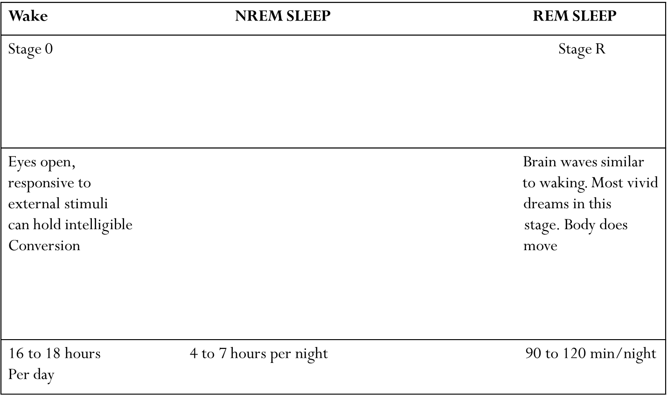
INTRODUCTION
Light Sleep Deep Sleep
Stage1 Stage2
Stage3
Transition between waking and sleep. If awakened person will claim was never asleep | Main body of light sleep. Memory consolidation Synaptic pruning | Slow waves on EEG readings.

Slide 7
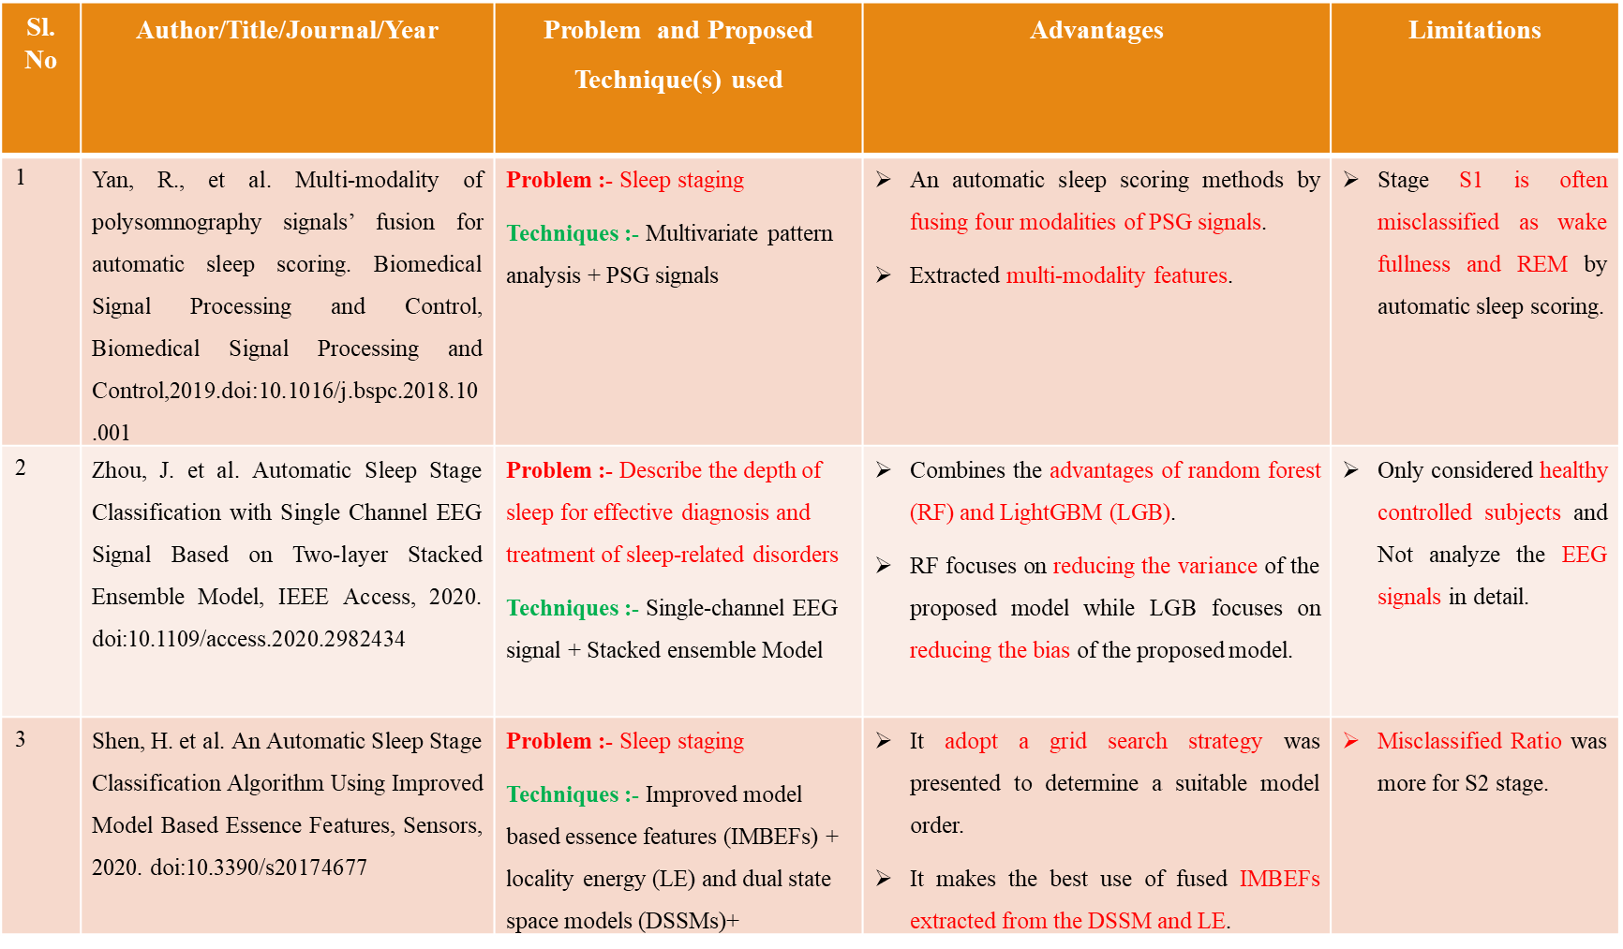
RELATED WORKS

Slide 8
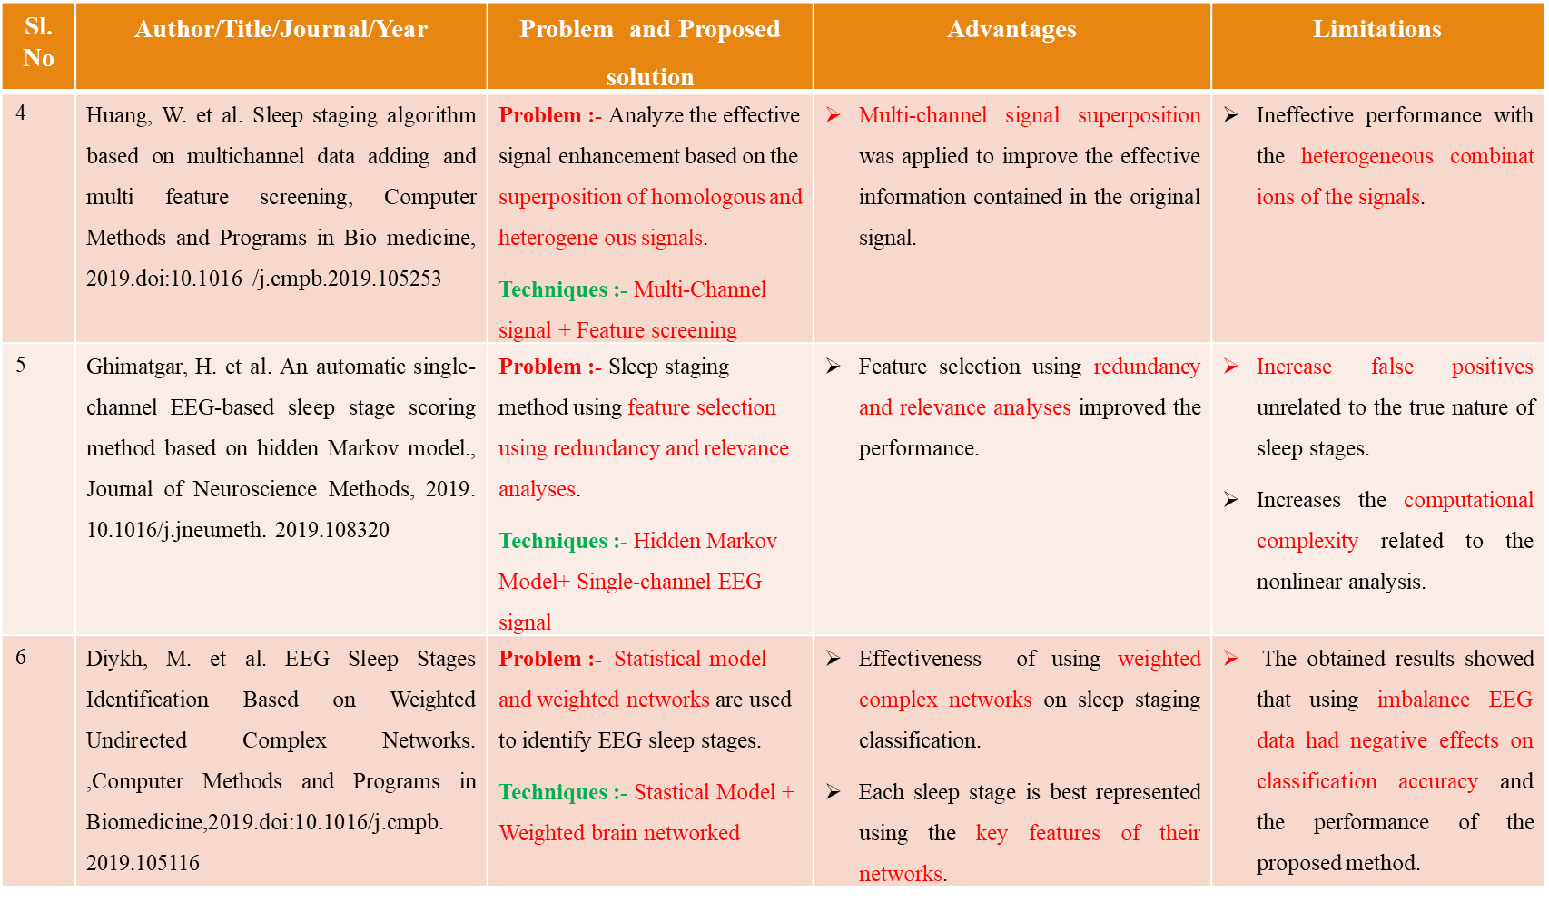
RELATED WORKS

Slide 9
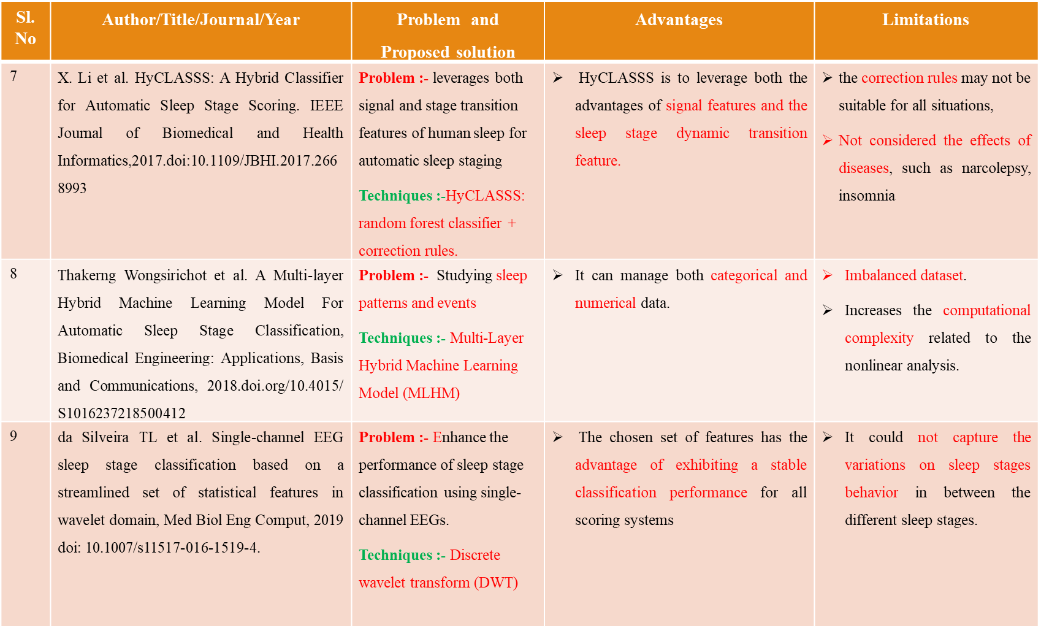
RELATED WORKS

Slide 10
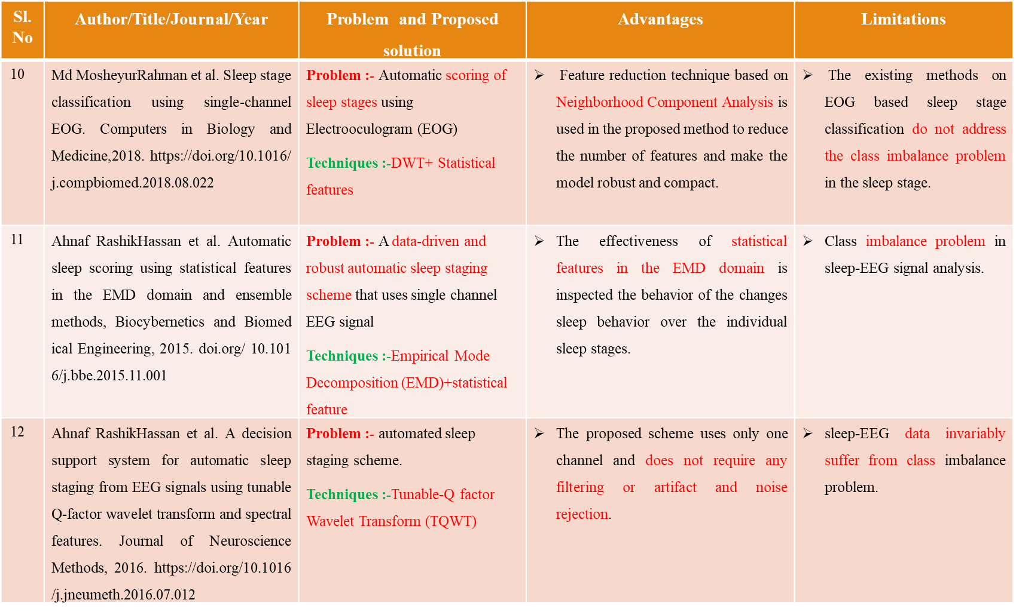
RELATED WORKS

Slide 11
INFERENCE FROM LITERATURE SURVEY
There is a lack of a generalized model, less labelled data, low sleep staging classification performance.
In most of the survey, the ML methods are designed with certain number of factors to classifying the stages without analysis the characteristics of the individual sleep stages.
Most of the classification algorithms are not adjust with the traditional features while dealing with sleep data of the subjects affected with multi-neurophysiological disorders.
Some of the individual ML algorithms are not properly performed for multi-class sleep stages (Five-Class).
Some of the classification algorithms are not correctly identify the changes sleep characteristics in the different stages of sleep due to improper feature combinations.

Slide 12
RESEARCH QUESTIONS FROM SURVEY
Which of the PSG signals are the most efficient in the detection of the different sleep stages?
Which feature extraction parameters from the PSG signals are most suitable to distinguish and characterize various sleep stages?
Are there significant differences in the PSG signals characterizing healthy subjects and patients with various sleep related disorders?
What is the best set of input signals and features for identifying the irregularities happened during sleep?
Can the new AASM staging definitions be used with an automated process to correctly identify the sleep stages?

Slide 13
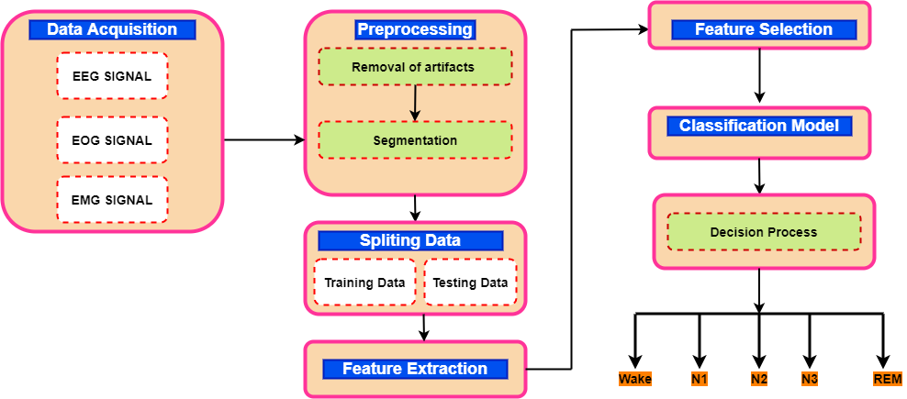
An Overview Of Sleep Staging Classification System

Slide 14
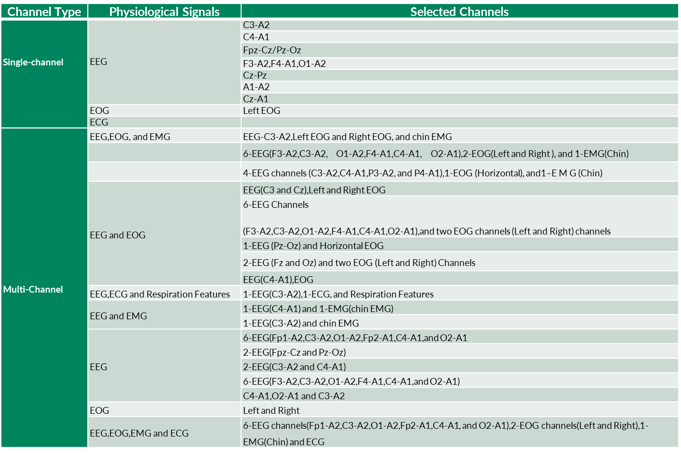
An Overview of Channels for Sleep Staging Classification System

Slide 15
Summary of feature and feature extraction approach in sleep staging classification problems
Feature Domains | Extracted Features
Time-domain | Statistical features
 | Zero crossing rate
 | Hjorth parameters
 | Mutual information
 | Shannon entropy
 | Renyi entropy
 | Tsallis entropy
 | Detrended fluctuation analysis
Frequency-domain | Harmonic Parameter
 | Spectral entropy
 | Coherence analysis
 | Parametric analysis
 | Non-parametric analysis
 | Median frequency
Time-frequency Domain | Wavelet Transform
 | Empirical Mode Decomposition
 | Winger Ville Distribution
 | Short-time Fourier Transform
Non-linear features | Hurst exponent
 | Permutation entropy
 | Multiscale Entropy
 | Sample Entropy
 | Approximate Entropy
 | Fractal dimension
 | Lyapunov exponent
 | Autoregressive

Slide 16
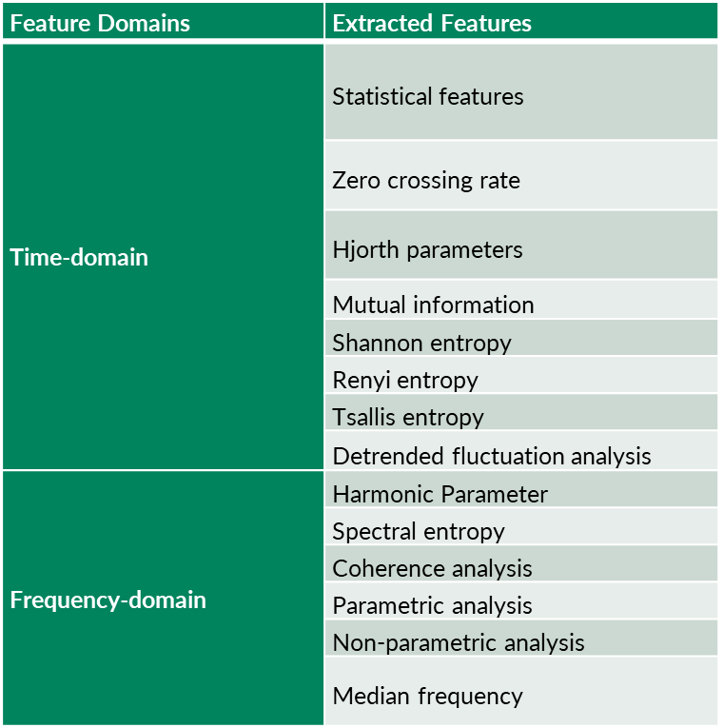
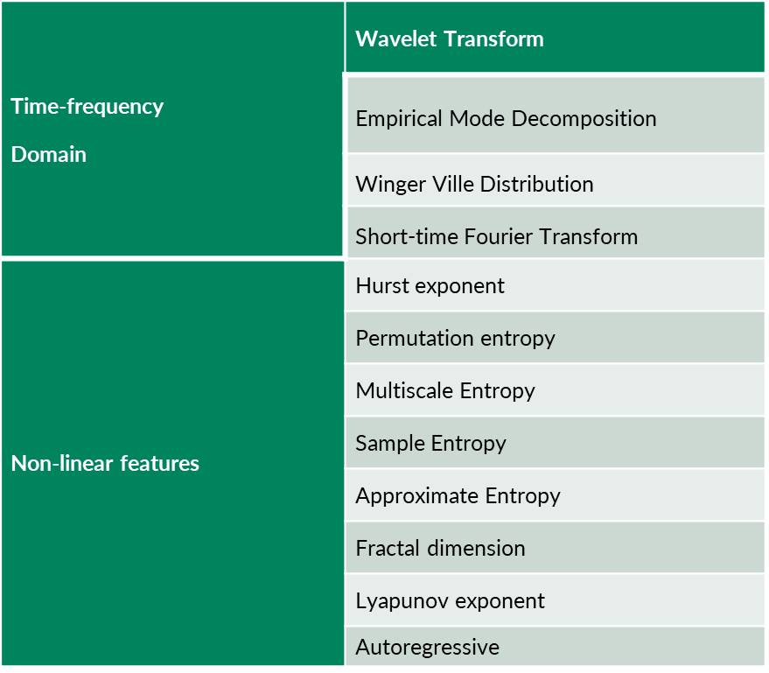
Summary of feature extraction approach in sleep staging classification problems

Slide 17
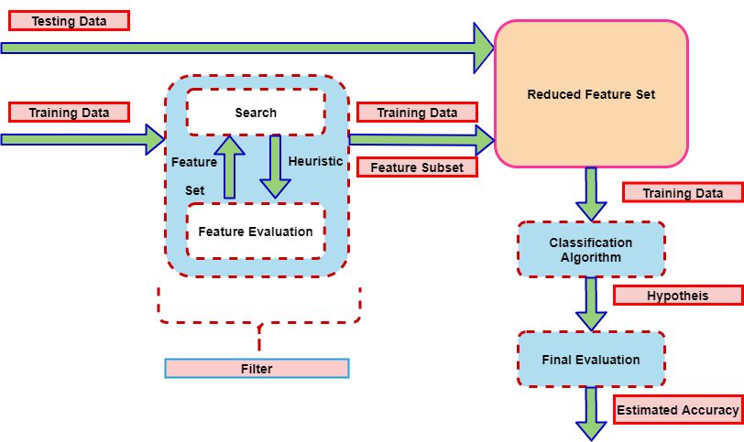
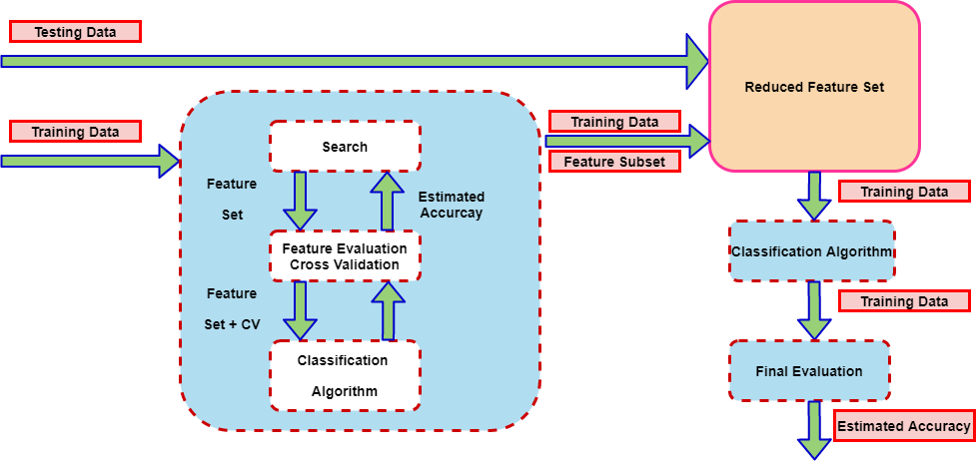
Summary of feature selection approach in sleep staging classification problems
Filter-based approach selection techniques
Wrapper-based approach selection techniques

Slide 18
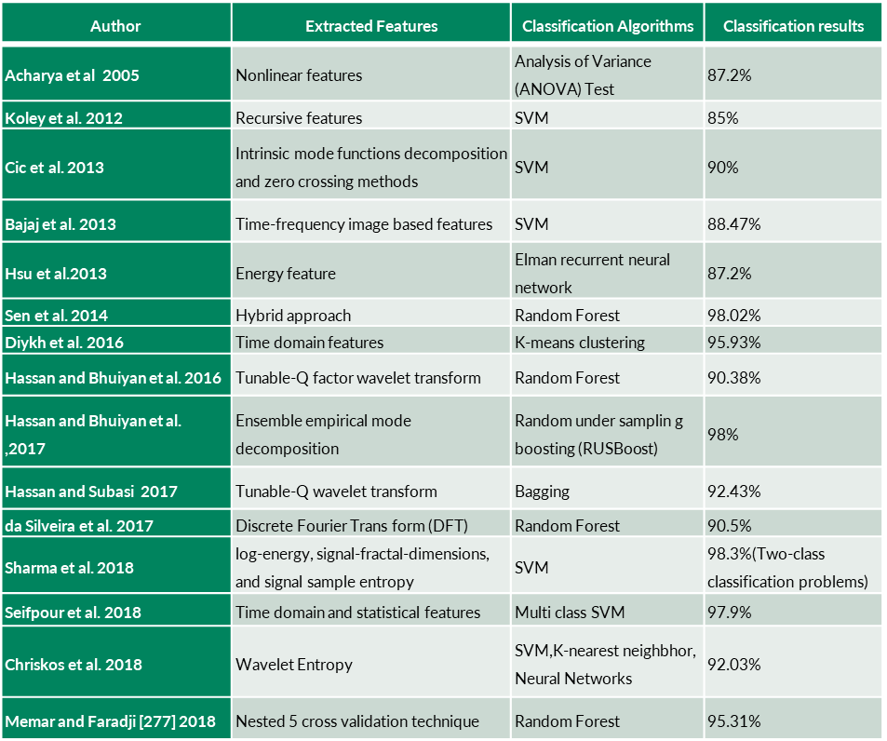
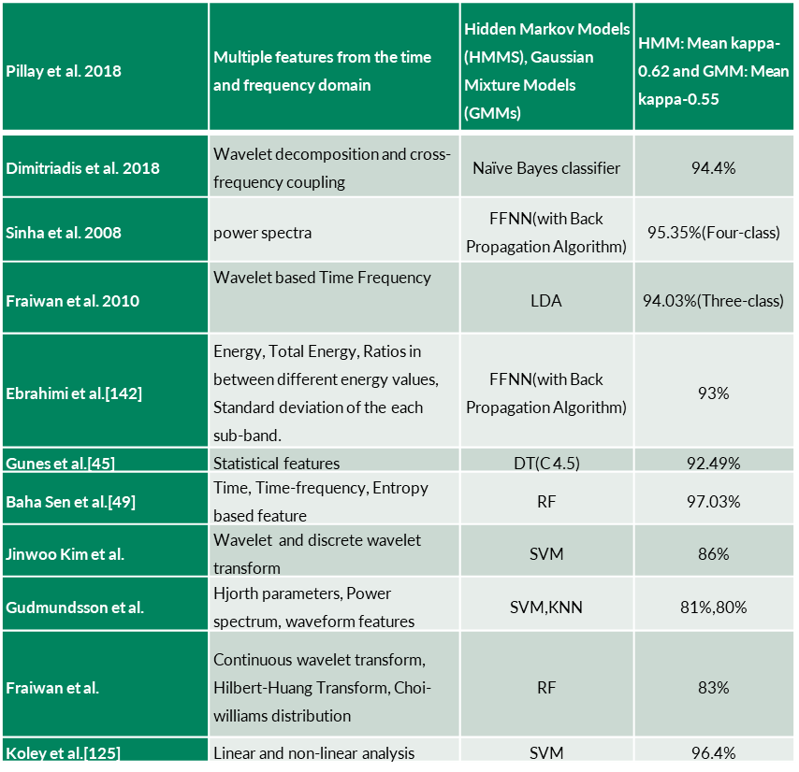
The Lists Of Contributed Research Works In Sleep Staging Using EEG Signals

Slide 19
The Lists Of Contributed Research Works In Sleep Staging Using ECG Signals
Author | Data | Feature extraction method | Classification method | Classification results
Alaa Sheta, 2021 [84] | Physionet’s CinC challenge-2000 database | Ensemble | KNN | 71.92%
Yücelbas¸ et al., 2018 [2] | Sleep laboratory of Necmettin Erbakan University database and PhyisioNet | Morphological methods | Random Forest, Wake, Non-REM, REM (WNR) | Up to 87.11% accuracy
Yoon et al., 2017 [12] | Twenty-one healthy subjects (male: 12, female: 9) and 30 subjects (male: 25, female: 5) with Obstructive Sleep Apnea (OSA) recorded at Seoul | HR Statistical parameters, Spectral power, variability measurements | Threshold, REM duration | 87.54%
Mendez et al., 2010 [19] | 24 subjects | HR statistics Spectral power | REM-NREM, HMM | 79.3%
Redmond et al., 2007 [6] | 31 male subjects | ECG derived respiration and HR statistics | WNR, Linear Discriminant Analysis (LDA) and a quadratic LDA | up to 76.1%
Redmond and Heneghan, 2006 [5] | 37 subjects | ECG derived respiration and HR statistics. EEG sleep staging for comparison | Evaluation of HR parameters during different sleep stages | Not reported
Penzel et al., 2003 [13] | 64 patients with symptoms of excessive daytime sleepiness and arterial hypertension | HR statistics, spectral power | Wake, light-, deep-sleep REM | Not reported

Slide 20
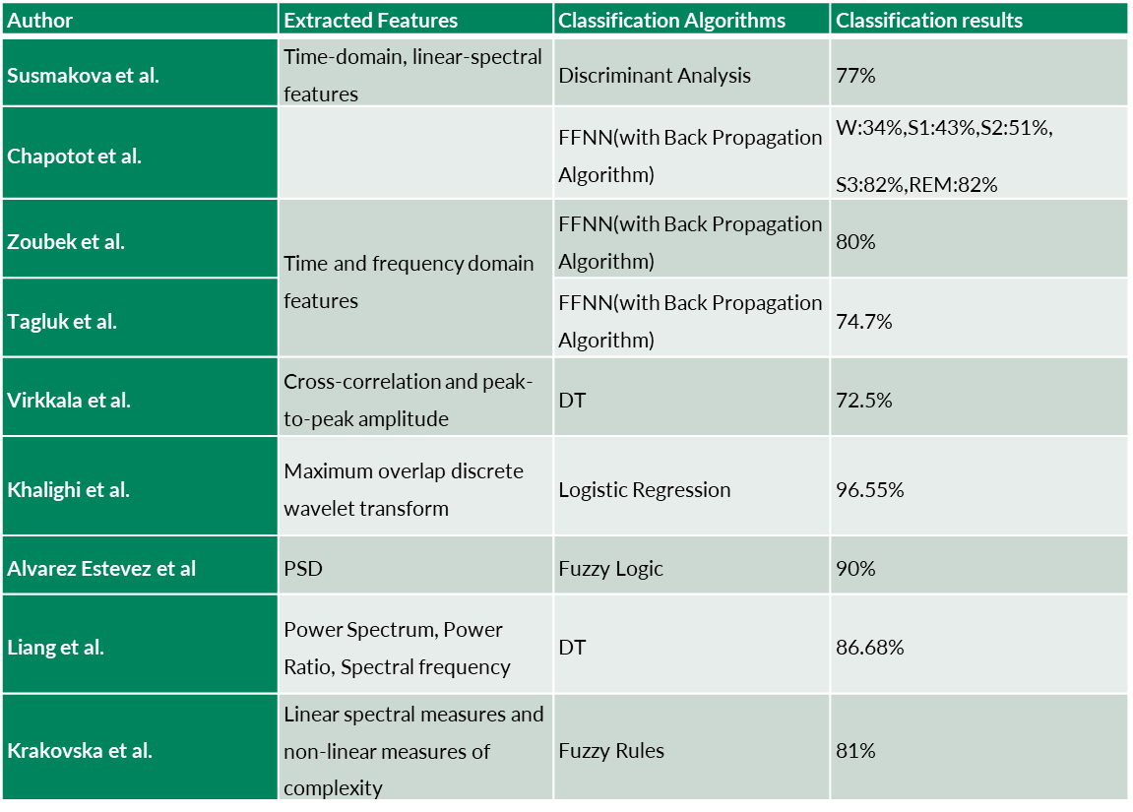
A Brief Lists Of Reviewed Sleep Studies Based On Polysomnography Signals

Slide 21
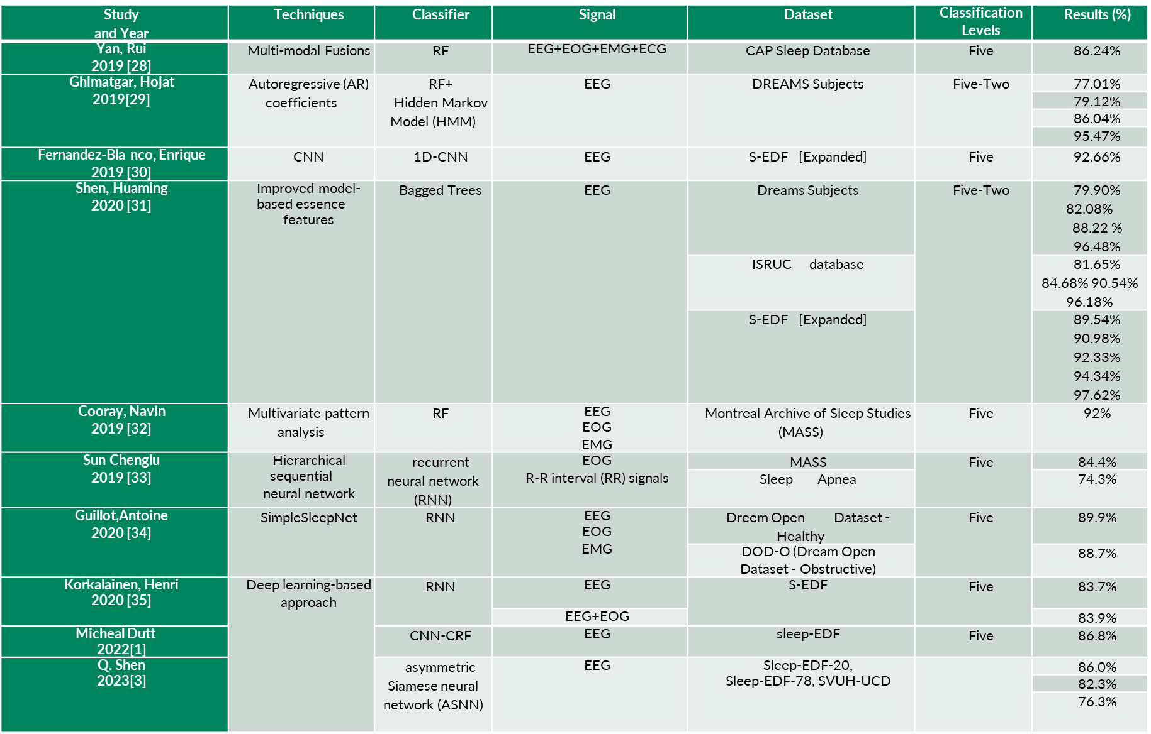
A Brief Lists Of Reviewed Sleep Studies Based On Polysomnography Signals

Slide 22
CONCLUSION
In this review, the recently contributed methods in sleep scoring systems based on ML and DL have been sincerely exercised, comparing these studies in different aspects.ML methodologies performed well for binary-class classification problems but poorly for multi-class classification problems.
The main limitation concerning ML algorithms is the required hand-crafted features for inspecting the changes in the behavior of sleep stages over the individual sleep stages. Another challenging job for ML algorithms is, identifying the relevance of the feature subject to the patient’s behavior.
In ML based sleep-scoring system, the selection of classification algorithms is also of difficult job. Sometimes it may directly impact the classification performance. Due to these limitations, most researchers adopted the DL approaches, making it more comfortable and accurate to discriminate the changes in sleep behavior over individual sleep stages. The most significant advantage of DL approach features is automatically recognized without explicit features. From this review, we have found that DL models achieved improved results compared to ML models.
This review helps to understand the significant improvements achieved and the limitations of sleep staging. Therefore, in this review study, we have pointed out that the future direction of the sleep scoring system should be multi-modal signal fusions.

Slide 23
FUTURE WORK
Applying data augmentation technique to overcome the class imbalance problem.
Extracting the proposed methodology by obtaining a non-linear artefact removal algorithm
Developing a prototype for automated sleep staging system software.
Applying multiple-classifier based on DL techniques to enhance the performance of sleep staging.
The performance of the proposed methodology can be improved by using different DL models.
Collect more real sleep datasets and improving the generalization ability of the learning algorithms.

Slide 24
REFERENCES
1.Panossian, LA., Avidan, AY.: Review of Sleep Disorders. Med. Clin. N. Am. 93,407–425 (2009).
2.Smaldone, A., Honig, JC., Byrne, MW.: Sleepless in America: inadequate sleep and re-lationships to health and well-being of our nation’s children. Pediatrics.119, 29–37(2007).
3.Satapathy, SK., Loganathan, D., Narayanan P. and Sharathkumar, S.: Convolutional neural network for classification of multiple sleep stages from dual-channel EEG sig-nals, 2020 IEEE 4th Conference on Information & Communication Technology (CICT), pp. 1-16 (2020)
4.Satapathy, SK. and Kondaveeti, HK.: Automated Sleep Stage Analysis and Classifica-tion Based on Different Age Specified Subjects from a Single-Channel of EEG Signal, 2021 IEEE Madras Section Conference (MASCON), pp. 1-7 (2021)
5.Surantha, N., Lesmana, TF. and Isa, SM.: Sleep stage classification using extreme learn-ing machine and particle swarm optimization for healthcare big data. J Big Data 8, 14 (2021).
6.Eldele, E. et al.: An Attention-Based Deep Learning Approach for Sleep Stage Classifi-cation With Single-Channel EEG, in IEEE Transactions on Neural Systems and Rehabil-itation Engineering, 29, 809-818 (2021)
7.Satapathy, SK., Ravisankar, M. and Logannathan, D.: Automated Sleep Stage Analysis and Classification Based on Different Age Specified Subjects From a Dual-Channel of EEG Signal, 2020 IEEE International Conference on Electronics, Computing and Communication Technologies (CONECCT),pp. 1-6 (2020)
8.Satapathy, SK., Loganathan, D.: Automated Accurate Sleep Stage Classification System Using Machine Learning Techniques with EEG Signals. In: Kannan, S.R., Last, M., Hong, TP., Chen, CH. (eds) Fuzzy Mathematical Analysis and Advances in Computa-tional Mathematics. Studies in Fuzziness and Soft Computing, vol 419. Springer, Singa-pore.
9.Liu, Cong & Tan., Bin & Fu., Mingyu & Li., Jinlian & Wang., Jun & Hou., Fengzhen & Yang, Albert.: Automatic sleep staging with a single-channel EEG based on ensemble empirical mode decomposition, Physica A: Statistical Mechanics and its Applications, Elsevier, vol. 567(C).
10.Satapathy, SK., Madhani, H., Garg, S., Swain, D. and Rajput, N.: AutoSleepNet: A Multi-Signal Framework for Automated Sleep Stage Classification," 2022 IEEE World Conference on Applied Intelligence and Computing (AIC),cpp. 745-750 (2022)

Slide 25

Questions ?

